Slide 1
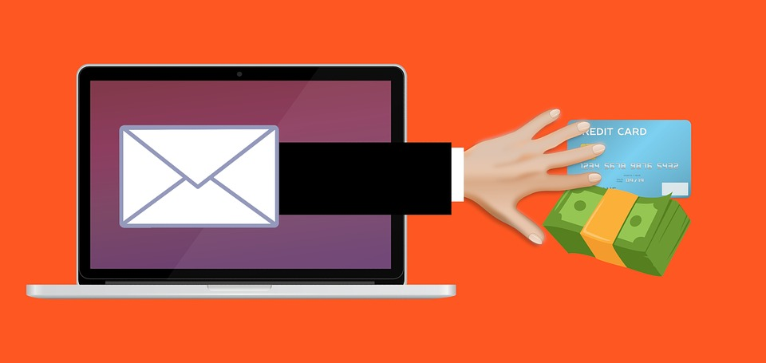
Phishing
Introduction

Slide 2
The Idea
Phishing
Usually the simplest way to get a victims password is asking for it
Why not using E-Mails, Phones, SMS or even Social Engineering?
The Ideas behind Phishing is getting access to a system (execution of malware) or simply asking for sensitive information.

Slide 3
Categories
Phishing – Threats
Spear Phishing
Smishing
Whaling
Vishing
Clone Phishing

Slide 4


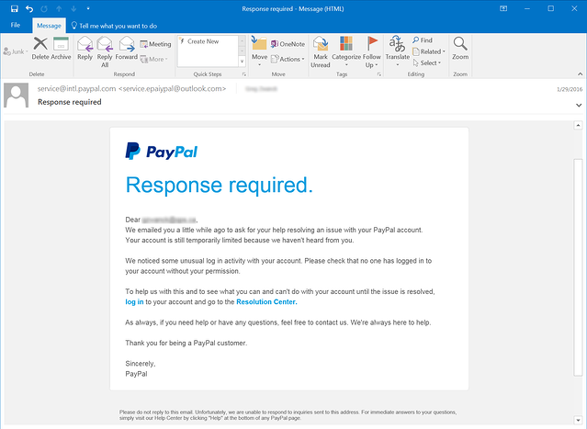





Spear Phishing
Phishing – Threats
The attacker targets a specific person of the organisation, this does not necessarily have to be the CEO
Sends a phishing email to the CEO

Slide 5
Spear Phishing – CEO Fraud
Phishing – Threats
The attacker targets a specific person of the organisation
The attacker mimics the CEO of the company
Sends a phishing email to person

Slide 6

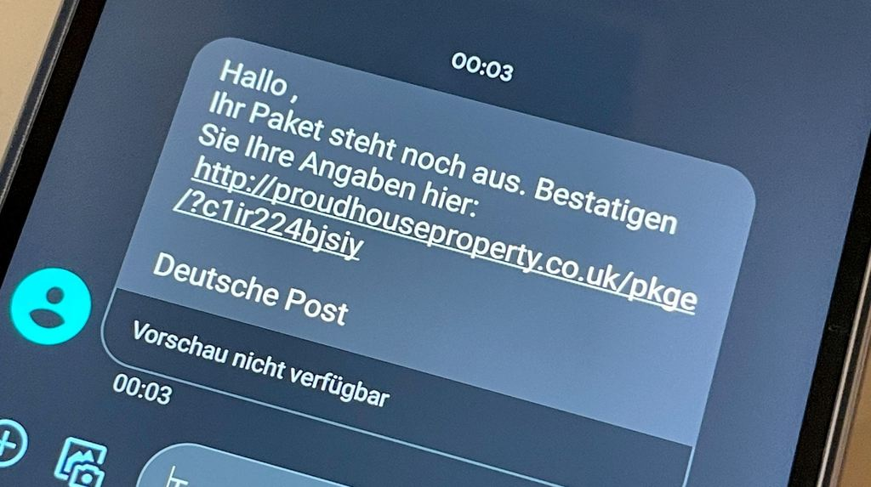
Smishing
Phishing
The Attacker sends a SMS to a specific person in an organisation, this does not necessarily have to be the CEO
Attacker send a SMS

Slide 7
Whaling
Phishing – Threats
Attacker sends a message to a key person in a organization
This is usually the CEO
Attacker send a SMS

Slide 8

Vishing
Phishing – Threats
The attacker calls someone from the company
Vishing is a combination of “voice” and “phishing”
Call someone from the company

Slide 9


Clone Phishing
Phishing – Threats
The attacker typically spoofs the sent E-Mail and makes a clone of it, then he replaces attachments and links with his owns.
The victim has the impression it’s from a legit sender
Links and attachments replaced with malware or malicious links

Slide 10
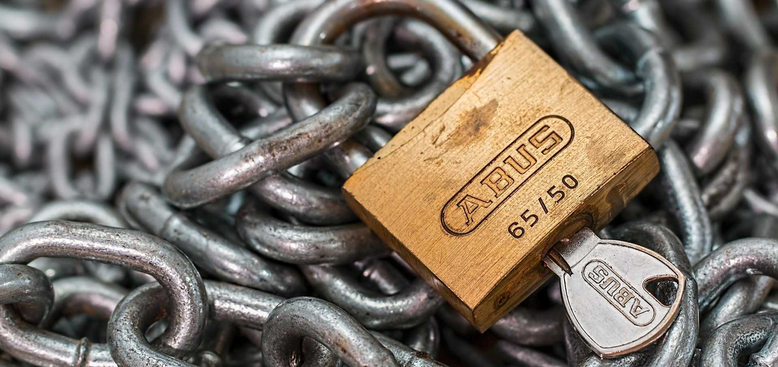
Mitigations
Phishing

Slide 11
Introduction
Phishing – Mitigations
There are different methods for mitigations
In the slides you are seeing a lot of technics, its split into
Technical
Personal

Slide 12
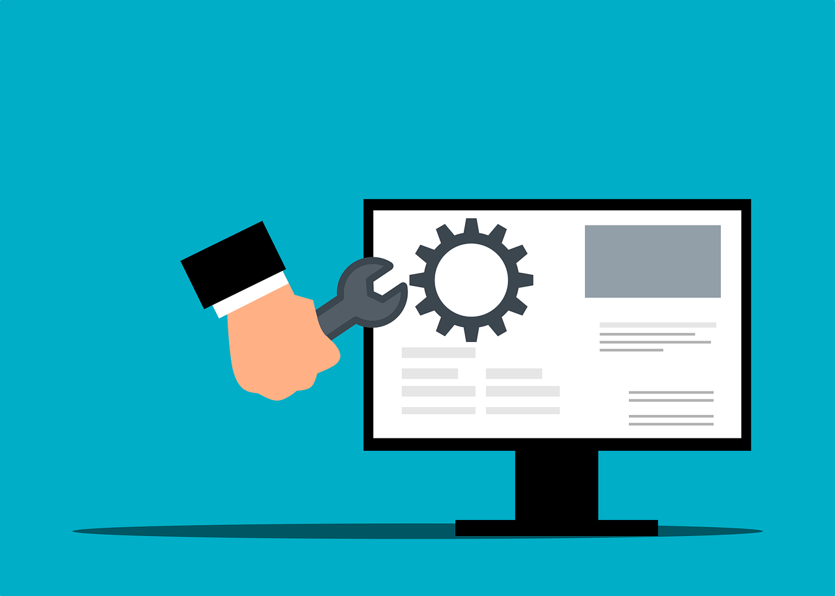
Technical
Phishing – Mitigations
SPF
DKIM
DMAC
BIMI
SPAM-Filter
Anti-Virus
Updates
Password manager

Slide 13
Sender Policy Framework - SPF
Phishing – Mitigations - Technical
Without SPF
With SPF
The receiving email server accepts bad E-Mail from foreign E-Mail servers.
The Server verifies the sender server with a defined Servers or Domain in the SPF Records.
Example
v=spf1 ip4:228.51.119.99 ip6:d5a5::2b7f –all
ip4:228.51.119.99 This Server is legit to send
ip6:d5a5::2b7f This Server is legit to send

Slide 14
DomainKeys Identified Mail - DKIM
Phishing – Mitigations - Technical
Without DKIM
With DKIM
The integrity of the E-Mail is not guaranteed
The E-Mail could be manipulated during the transmission
The E-Mail has a asymmetric signature appended
The E-Mail server makes a validation with a corresponding public available with DNS
Example of DNS records
v=DKIM1; p=76E629F05F70…6CBE

Slide 15
Domain-based Message Authentication Reporting and Conformance - DMARC
Phishing – Mitigations - Technical
Without DMARC
With DMARC
The receiving Email server does not know how to handle the received email.
The “mimicked” sender domain has no information available of the spam
The receiving server of the fake email takes actions according to the sender domains DMARC
Example
v=DMARC1;p=reject;pct=100;rua=mailto:postmaster@dmarcdomain.com
p=reject Reject the E-Mail
pct=100 Procentage to filter
rua=mailto:postmaster@dmarcdomain.com Sends aggregated report

Slide 16
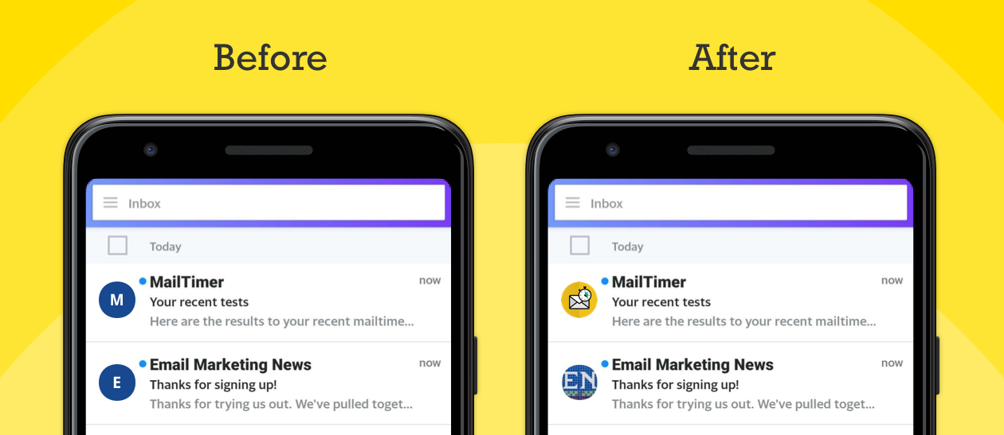
Brand Indicators for Message Identification - BIMI
Phishing – Mitigations - Technical
Without BIMI
With BIMI
No Logo is shown by the E-Mail Client
After the receiving party has verified the E-Mail it can if defined by the sender domain, display a Logo on the E-Mail Client

Slide 17
SPAM-Filter
Phishing – Mitigations - Technical
General
Types
Is a SMTP relay for detecting SPAM email
Content Filters
Blacklist Filters
Header Filters
Language Filters
Rule-based Filters
Bayesian Filters

Slide 18
Other
Phishing – Mitigations - Technical
Anti-Virus
It can check the attachments in an E-Mail for malicious content
Updates
Updates the software and operating system is always a good practice
Password Manager
The store unique password in a safe place
The also keep track the URL to fill-in the password and username on legit sites

Slide 19
Personnel
Phishing – Mitigations
Personnel
Awareness Training
Reporting
Marketing
Principles/Policies
Password Policies
MFA/2SV
Response-Plan
Inform
Knowledge base
Limit presence in OSINT

Slide 20

Awareness Training
Phishing – Mitigations – Personal
Personal is usually the first line of defence
The personal should be trained for detecting fake E-Mails
The following are some examples of technics
Poster
Gamification of Phishing
Planned Phishing Attacks on the Employees
Live Demonstration
Video-based

Slide 21

Reporting
Phishing – Mitigations – Personal
A Phishing can not only be detected technically
It’s also important to give people the possibility to report E-Mails
Directly
Form-based
Paper-based
This makes sure the IT department is ware of

Slide 22
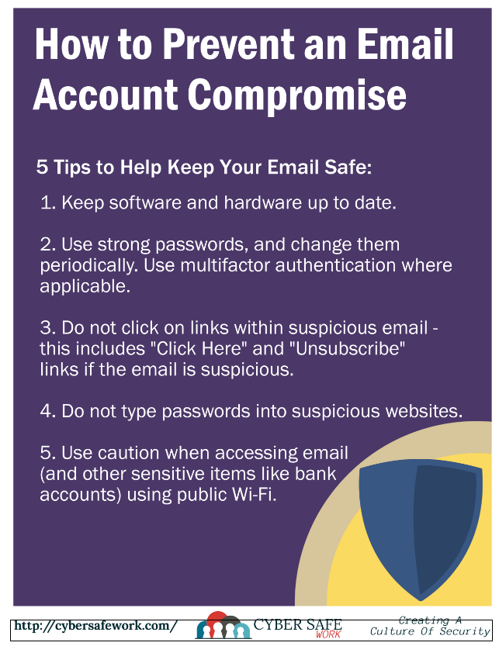
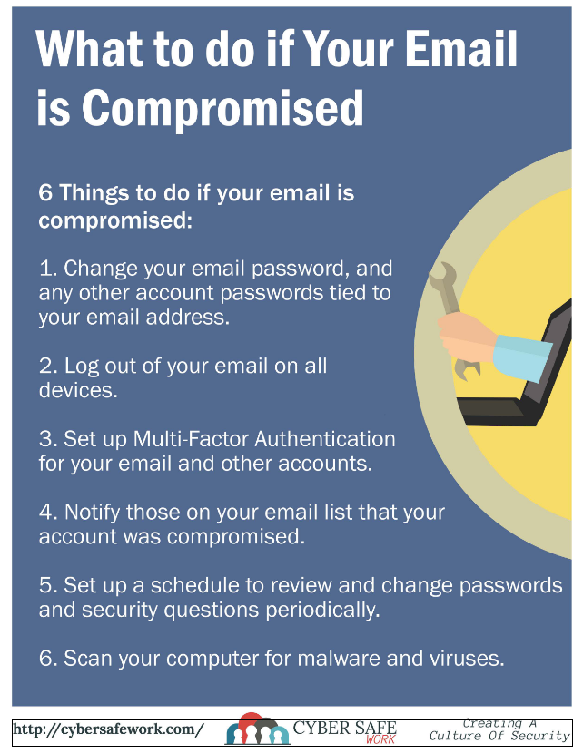
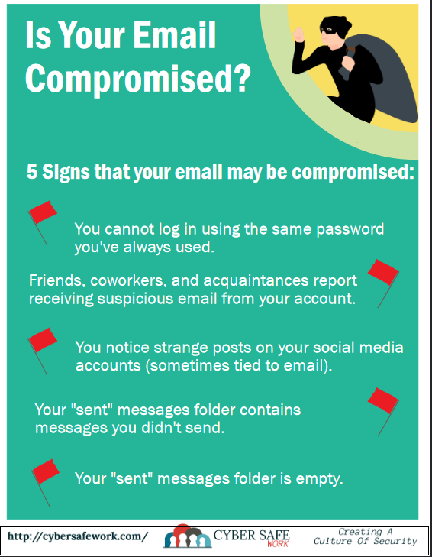
Marketing
Phishing – Mitigations – Personal
SPAM through marketing campaigns such as posters or active information events
https://cybersafework.com/wp-content/uploads/2022/01/March2022.pdf
https://cybersafework.com/wp-content/uploads/2022/01/February2022.pdf
https://cybersafework.com/wp-content/uploads/2021/11/Compromised-Email.pdf

Slide 23
Principles/Policies
Phishing – Mitigations – Personal
It can help in a organisation on how to handle E-Mails
Some examples
Do not click on unknown links
Do not give your credentials to an unsecured site
Double-check the URL of the website before giving your credentials
Password is never asked from the company
Bank details will not change at any point
Watch out for shortened links
Be aware of pop-ups

Slide 24
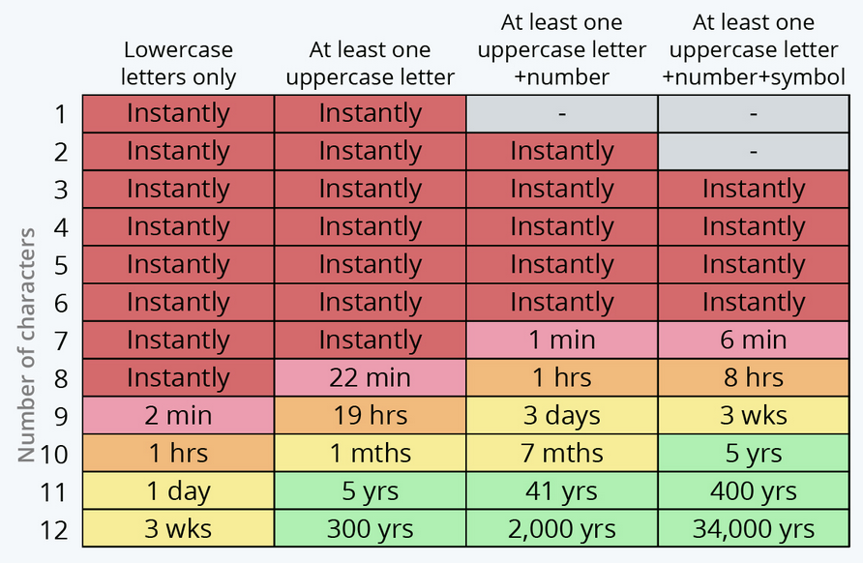
Password Policies
Phishing – Mitigations – Personal
Password policies can also help indirectly
If the personal puts in the password on not authorised sites
No password policies can help
The picture show how long it takes to crack passwords
Is your password safe?

Slide 25

Multifactor Authentication (MFA)/ 2-Step-Verification (2SV)
Phishing – Mitigations – Personal
Use besides the password other authentication mechanisms
Examples
Biometric
Smart Cards
Smart Phones
Hardware Keys
…

Slide 26
Response-Plan
Phishing – Mitigations – Personal
Usually you only take real actions to prevent such a scenario, as soon as it occurs
As long as it not occurred you have the time define the steps
Define on how to handle such a incident
It defines the responsibilities
It defines the contacts
It defines the steps
And more

Slide 27


Other
Phishing – Mitigations – Personal
Look a the impressum to find the E-Mail pattern
A great contact is h.muster@example.com
Inform
Inform the people about current SPAM situation
Knowledge Base
Centralise the knowledge of the spam.
Let them write their experience for others
Limit available information on the web
Limit the information of the staff on your website
Attackers can learn how your organisation is structured from that
/impressum
Look a the team site. Usually you find the Name attached to different person pictures or in the file name of the pictures.
“Great can add 40 people to the list”
Create a Spam List.
/teams

Slide 28
Phishing detection
Phishing – Mitigations – Personal
Some tips
Double-check the name and E-Mail
Check if Domains alters. (example.com / exomple.com)
Is the spelling correct?
Over with the mouse over the links
Hover over attachments to see if a link is displayed or not.
Delete any suspicious emails before opening it.

Slide 29
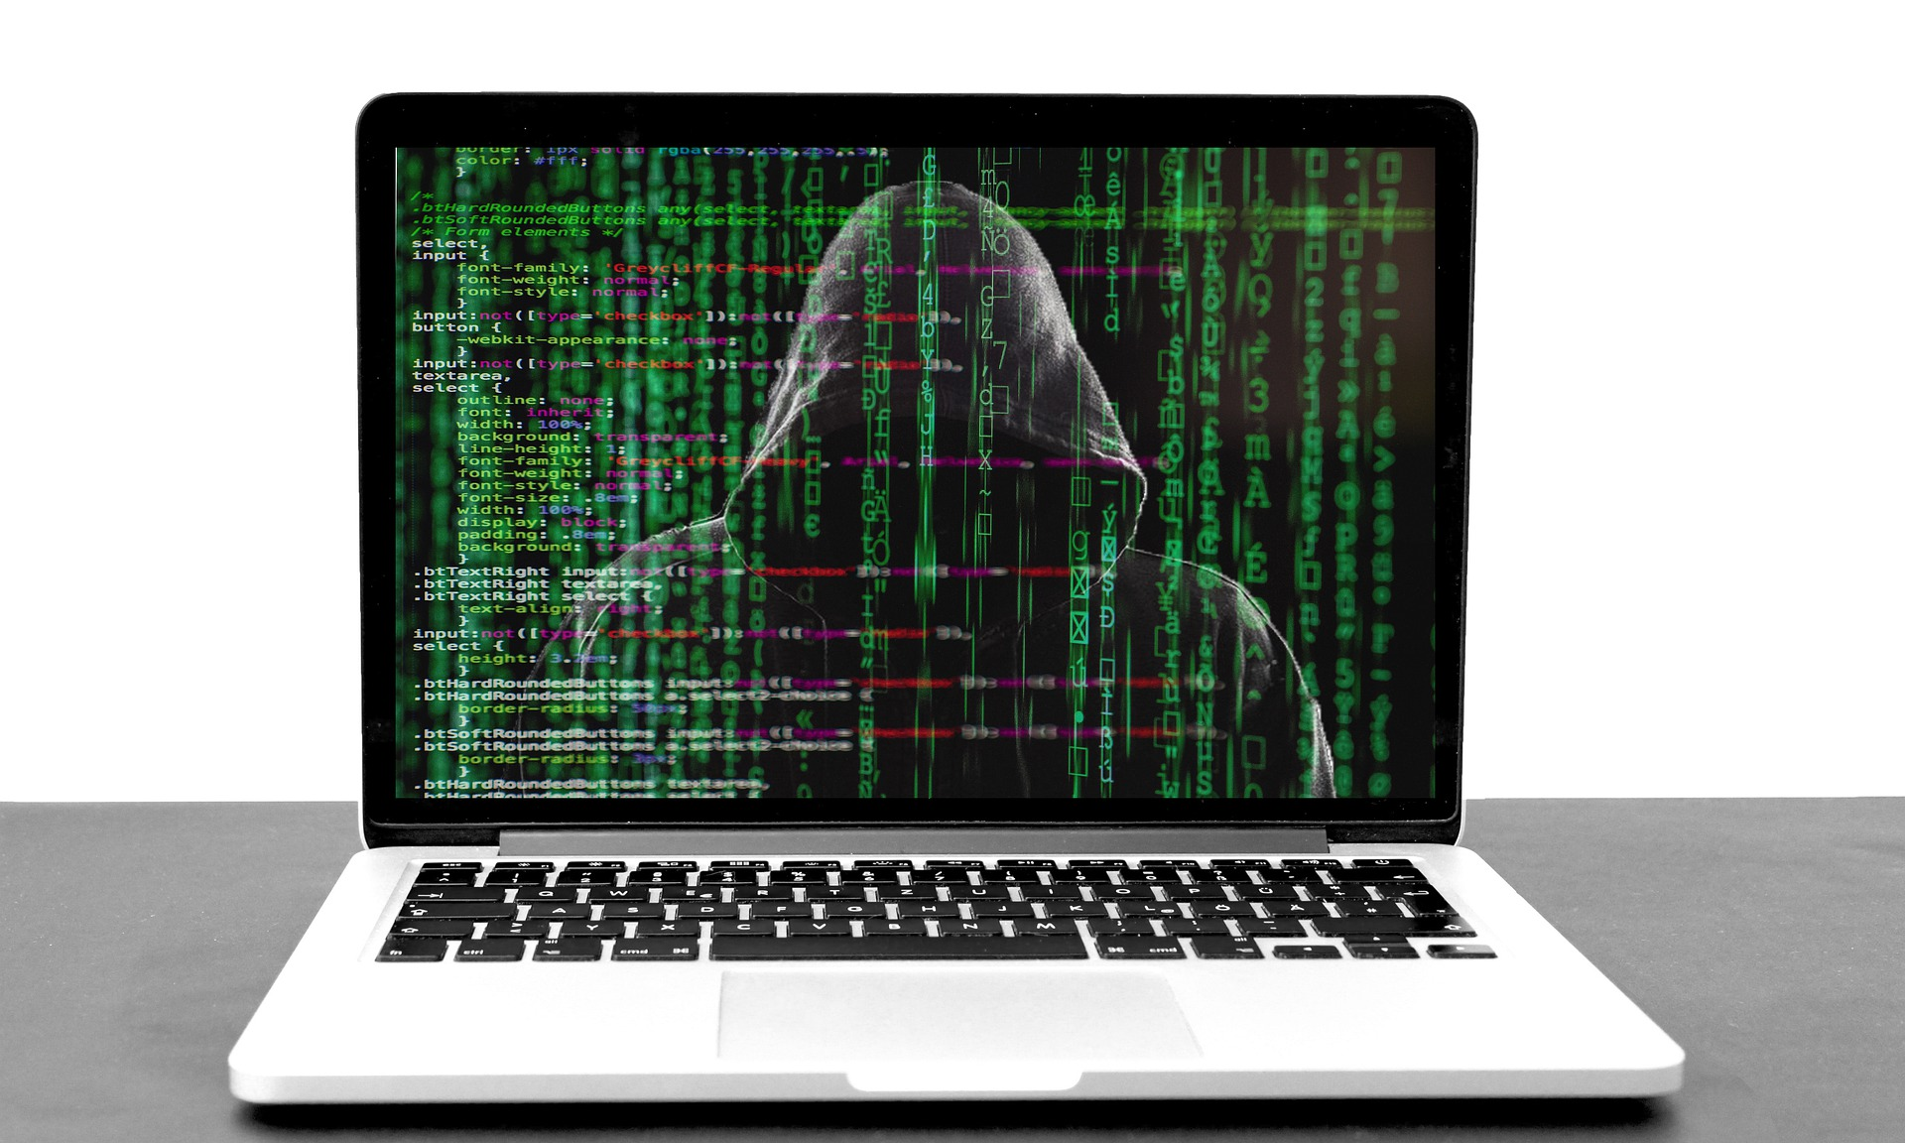
After clicking on a phishing email
Phishing – Mitigations – Personal
Immediately report it to the IT department
Unplug the internet physically from the machine
Don’t panic

